Slide 1

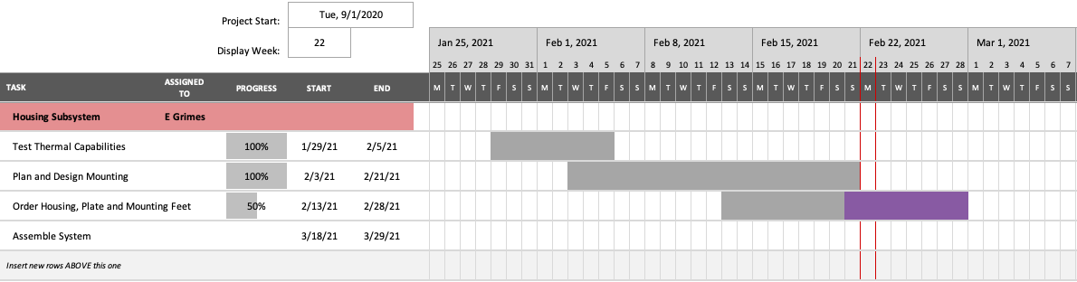
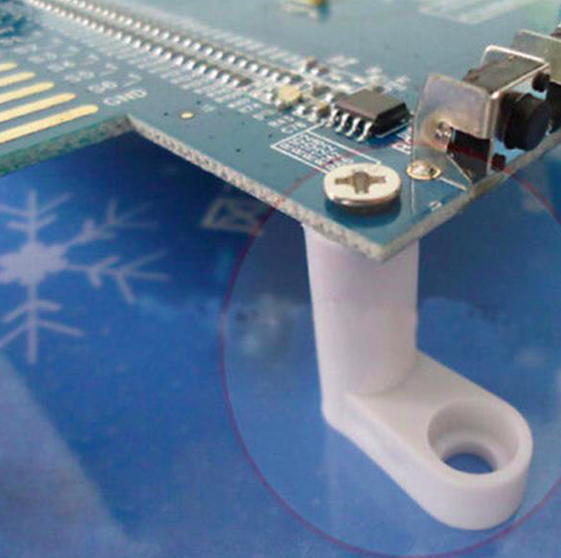
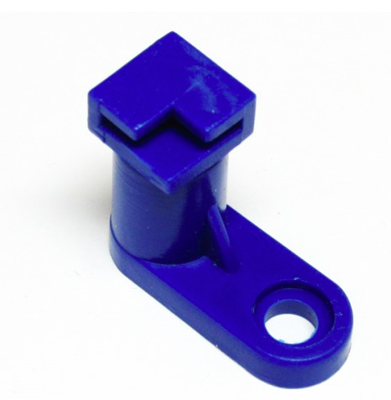

CervPro
Cervical Proprioception Diagnosis: A3 Status
Date: February 23, 2021
Members: Nathan Vielmette, Ethan Grimes, Keneth Chelelgo, and George Cook
Background
PT cervical proprioception (CP) assessments are subjective and determined by PT opinion.
Motivation is to create device that gives PTs objective data that shows patients’ ability to sense head and neck position in space.
Device will sense head position and angular velocity.
Proposed Countermeasures
Compare and evaluate different PCB mounting feet that utilize the holes in the BT microprocessor
Recent Results
Purchase Request form for Housing and mounting plates sent in
Internal component layout finalized
Ensured enclosure will still fit microprocessor with cooling tower installed
Mounting plan designed
Current Conditions
Comparing PCB mounting feet for purchase
Waiting on SK-19 Enclosure and Panel to Ship
Goals/Targets
Use of device will be faster than double standard CPE test time ~10 min
Patient will not need to touch any part of device
Accurately measures head position and speed within 5% error margin
Device will be move and <10lbs
Analysis
BT microprocessor shape may not be conducive to the PCB mounting feet
Next Steps
Wait for enclosure and panel to arrive
Select and purchase mounting feet

Slide 2
CervPro
Cervical Proprioception Diagnosis: A3 Status
Date: February 23, 2021
Members: Nathan Vielmette, Ethan Grimes, Keneth Chelelgo, and George Cook

Slide 3
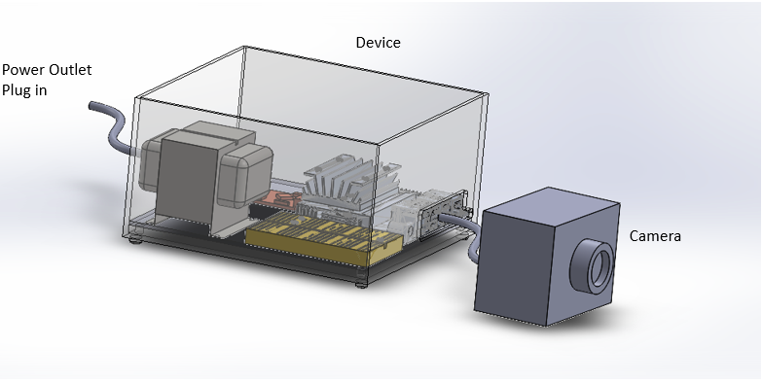
CervPro
Cervical Proprioception Diagnosis: A3 Status
Date: February 23, 2021
Members: Nathan Vielmette, Ethan Grimes, Keneth Chelelgo, and George Cook

Slide 4

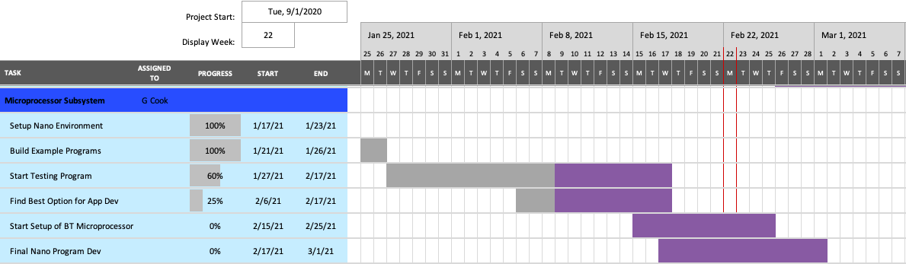
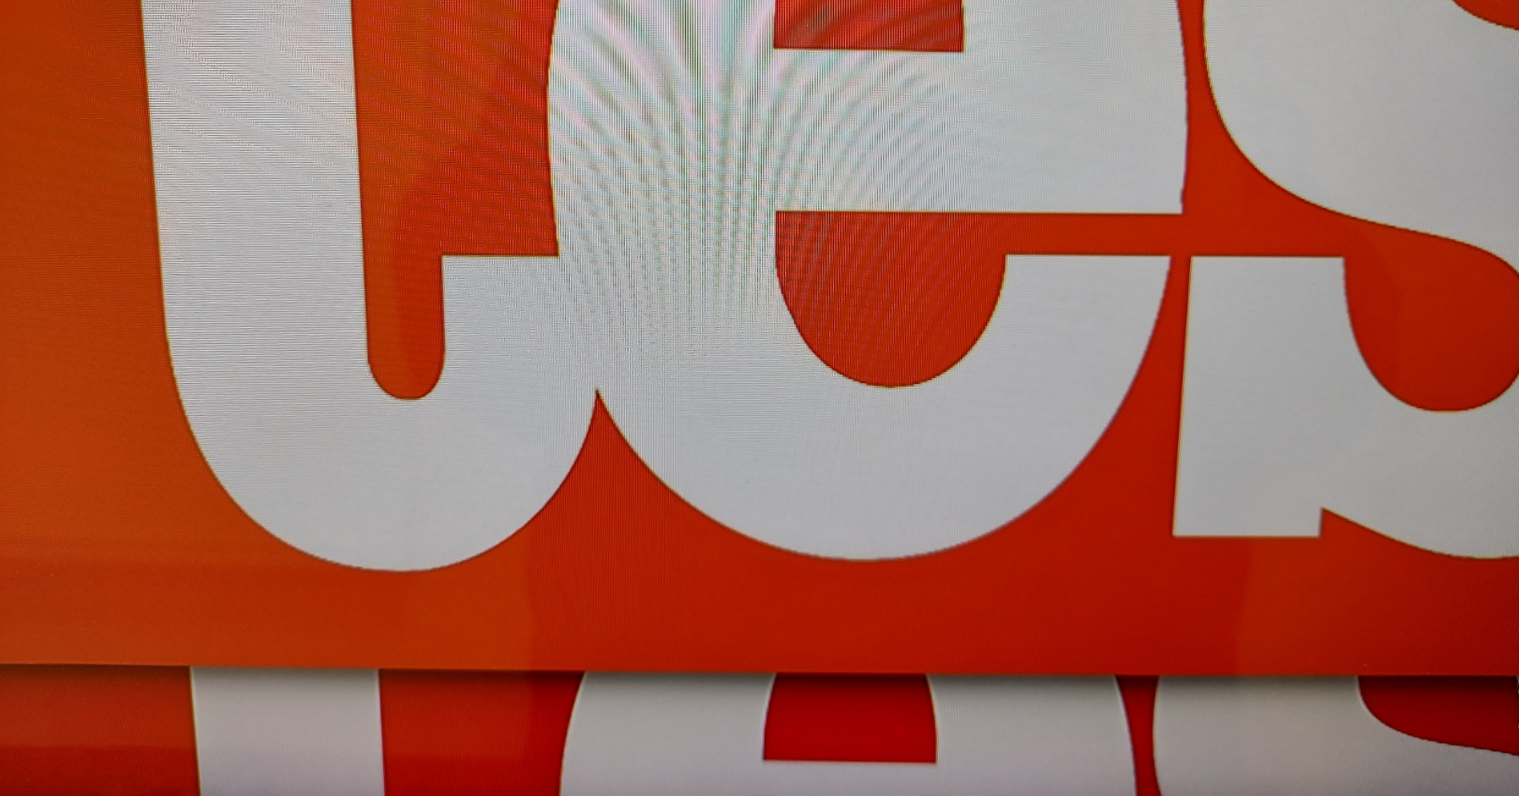
CervPro
Cervical Proprioception Diagnosis: A3 Status
Date: February 23, 2021
Members: Nathan Vielmette, Ethan Grimes, Keneth Chelelgo, and George Cook
Background
PT cervical proprioception (CP) assessments are subjective and determined by PT opinion.
Motivation is to create device that gives PTs objective data that shows patients’ ability to sense head and neck position in space.
Device will sense head position and angular velocity.
Proposed Countermeasures
Change schedule to where the snow does not affect development
Use the only available resource
Use the camera on my laptop when taking images
Investigate conditional options in the configuration file
4. Build for version 10+ minimum
Current Conditions
Testing preprocessing algorithm
A little behind on Bluetooth development
Recent Results
Developed a preprocessing algorithm for increasing image exposure/lightness
Found a Bluetooth development environment
Version 10+ configuration file made
Got the drive for the PS Eye to be able to run it for testing on my laptop
Goals/Targets
Use of device will be faster than double standard CPE test time ~10 min
Patient will not need to touch any part of device
Accurately measures head position and speed within 5% error margin
Device will be move and <10lbs
Analysis
Snow/ice is making testing the preprocessing algorithm difficult
Lack of Bluetooth development tools
Inconsistent ability to use the camera in programs
Different configuration requirements for Android 9- vs. 10+
Next Steps
Test the preprocessing algorithm
Compare the preprocessing algorithm to additional lighting
Start Bluetooth development

Slide 5
CervPro
Cervical Proprioception Diagnosis: A3 Status
Date: February 23, 2021
Members: Nathan Vielmette, Ethan Grimes, Keneth Chelelgo, and George Cook

Slide 6
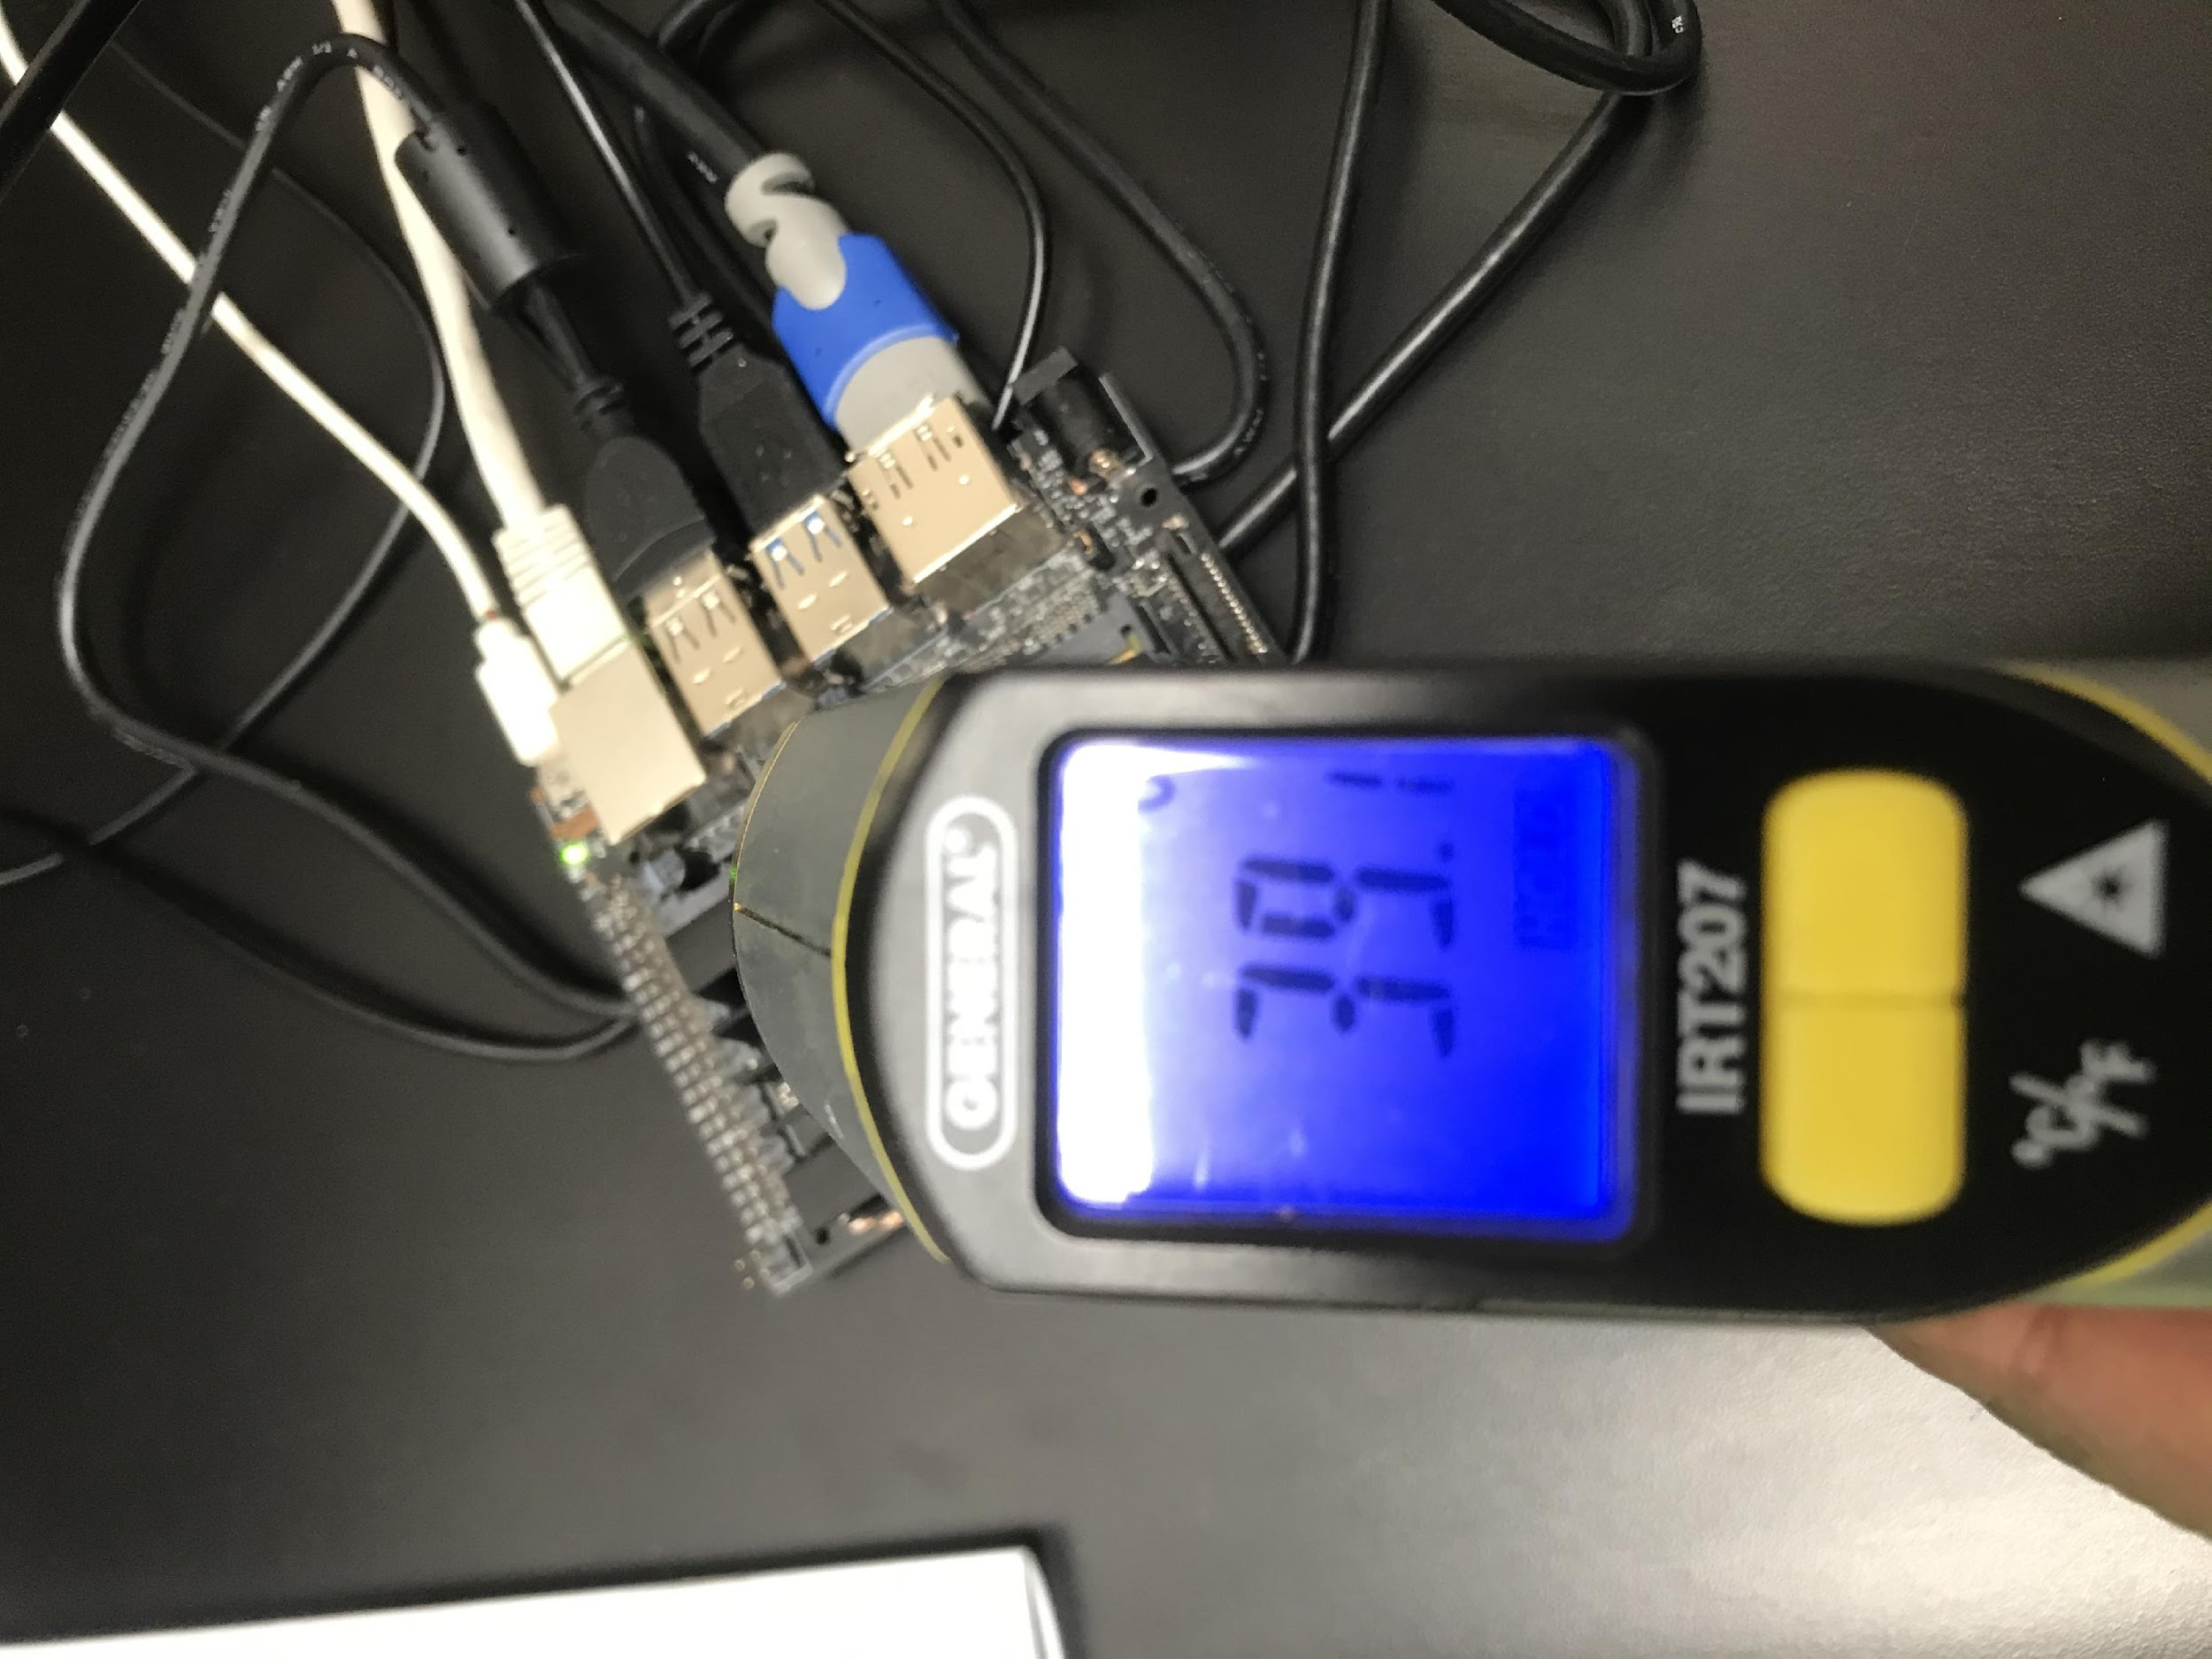
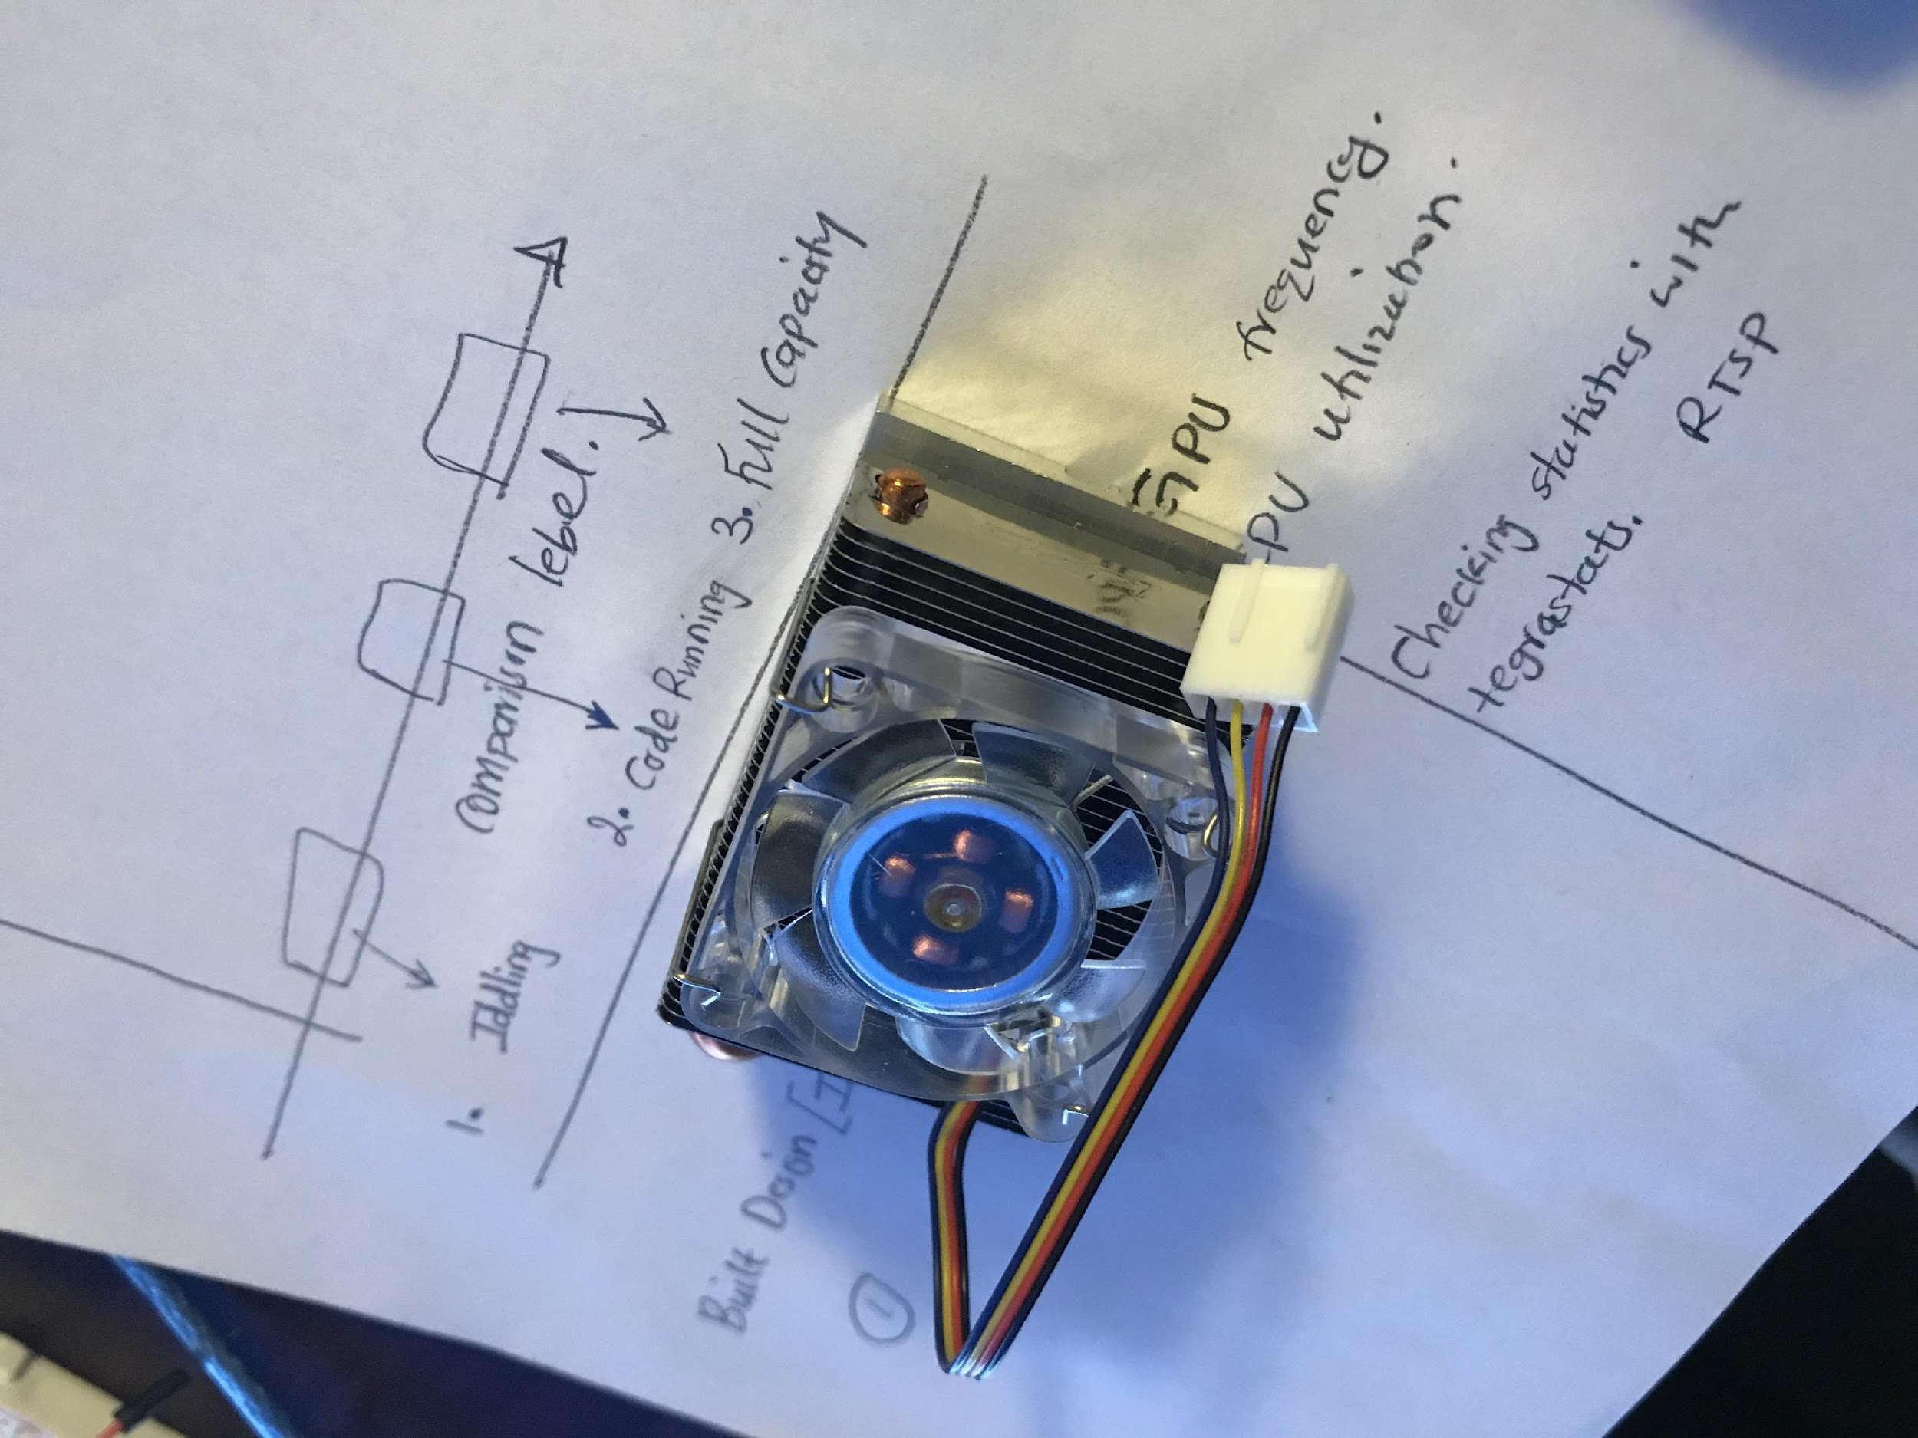
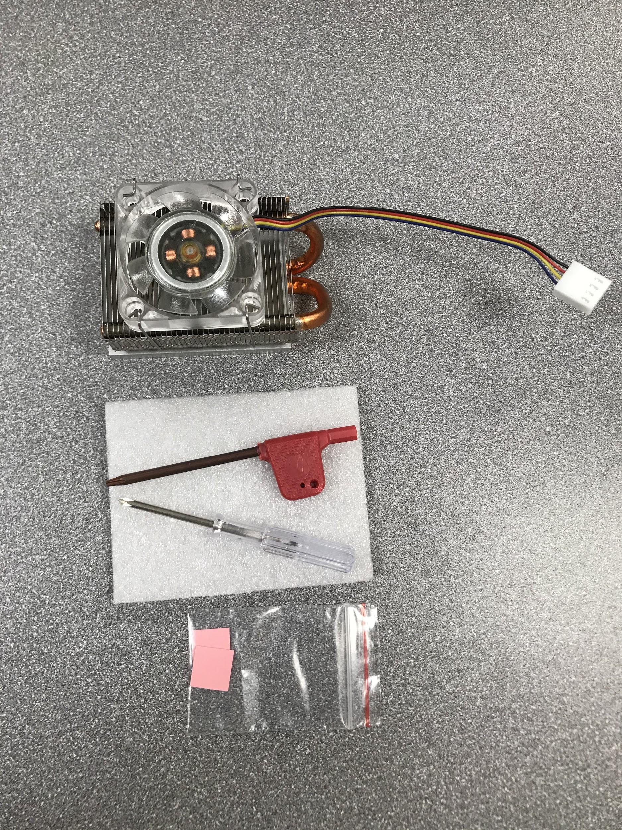
CervPro
Cervical Proprioception Diagnosis: A3 Status
Date: February 23, 2021
Members: Nathan Vielmette, Ethan Grimes, Keneth Chelelgo, and George Cook
Background
PT cervical proprioception (CP) assessments are subjective and determined by PT opinion.
Motivation is to create device that gives PTs objective data that shows patients’ ability to sense head and neck position in space.
Device will sense head position and angular velocity.
Proposed Countermeasures
1. Performing a test on the microprocessor.
2. Tracking microprocessor activity while comparing with temperature.
Recent Results
The weight is 0.1695lb
The results when the
Microprocessor is
Temperatures ranges from 33℃ to 39 ℃ while idling.
Assembly tools ready for installation.
Current Conditions
The ICE has been received and initial testing completed.
30% following the testing plan
Accomplished thermal analysis
Not started testing the ICE ON MICROPROCESSOR
Figure 1. Heat Sinks temp reading
Next Steps
Assemble and install ICE Tower to the Microprocessor.
Test ICE Tower performance on the Microprocessor.
Goals/Targets
Use of device will be faster than double standard CPE test time 10min.
Patient will not need to touch any part of device
Accurately measures head position and speed within 5% error margin
Device will be move and <10lbs
Analysis
1. The ICE tower prevent thermal throttling and overheating hence improving performance within the expected operating temperature of less than 50℃
2. The weight is significantly less than 10lbs.
Figure 2. Purchased ICE TOWER
Figure 3. Assembly tools

Slide 7
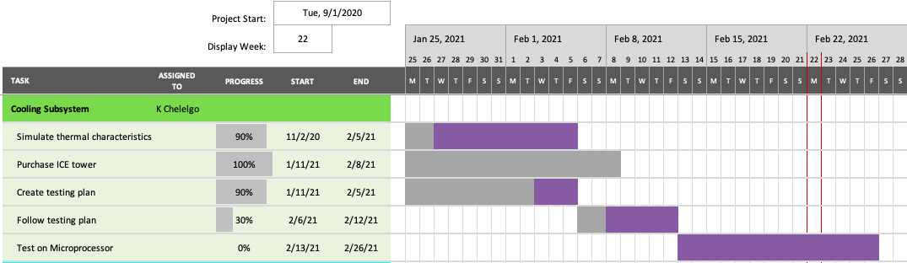
CervPro
Cervical Proprioception Diagnosis: A3 Status
Date: February 23, 2021
Members: Nathan Vielmette, Ethan Grimes, Keneth Chelelgo, and George Cook

Slide 8

CervPro
Cervical Proprioception Diagnosis: A3 Status
Date: February 23, 2021
Members: Nathan Vielmette, Ethan Grimes, Keneth Chelelgo, and George Cook
Independently testing the ICE Tower.
Independently testing the ICE Tower
The fan is working with sound and vibration low.
5 voltage power source from the arduino was used. .
Figure 4. The results of the ICE Tower connected to power source.

Slide 9
CervPro
Cervical Proprioception Diagnosis: A3 Status
Date: February 23, 2021
Members: Nathan Vielmette, Ethan Grimes, Keneth Chelelgo, and George Cook
Independently testing the ICE Tower.
Assembly tools to be used.

Slide 10
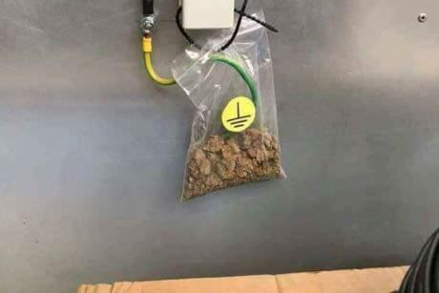
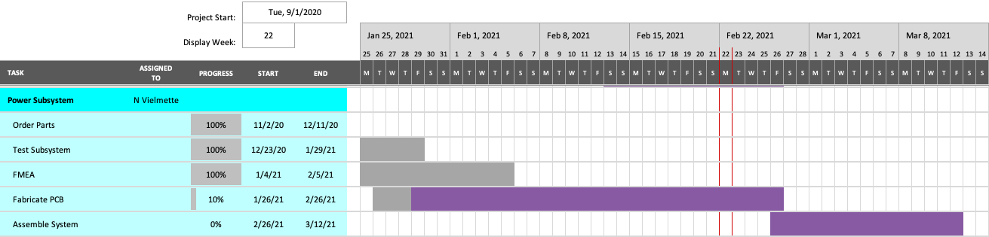
CervPro
Cervical Proprioception Diagnosis: A3 Status
Date: February 23, 2021
Members: Nathan Vielmette, Ethan Grimes, Keneth Chelelgo, and George Cook
Background
PT cervical proprioception (CP) assessments are subjective and determined by PT opinion.
Motivation is to create device that gives PTs objective data that shows patients’ ability to sense head and neck position in space.
Device will sense head position and angular velocity.
Proposed Countermeasures
Dedicate weekend in project lab
Recent Results
Obtained access to requisite HU database to adjust PCB fiducials
Confirmed biomed compliance issues are covered by design
Troubleshot and finalized Gerber files and prepped Protomat
Current Conditions
Testing either begun or finished
in 2/3 subsystems
A little behind on PCB construction
Goals/Targets
Use of device will be faster than double standard CPE test time
Patient will not need to touch any part of device
Accurately measures head position and speed within 5% error margin
Device will be move and <10lbs
Next Steps
Machine PCB (Nathan)
Source plugs and cables
Final functionality test
Analysis
Plotting PCB with Protomat

Slide 11
CervPro
Cervical Proprioception Diagnosis: A3 Status
Date: February 23, 2021
Members: Nathan Vielmette, Ethan Grimes, Keneth Chelelgo, and George Cook

Slide 12
CervPro
Cervical Proprioception Diagnosis: A3 Status
Date: February 23, 2021
Members: Nathan Vielmette, Ethan Grimes, Keneth Chelelgo, and George Cook
Fig. 1: Prototype of ESD/Grounding System

